Slide 1
R-Ladies Orlando August 2017 Launch Meeting
library(dplyr)
rladies_global %>%
filter(city == ‘Orlando’)

Slide 2

A Very Special Thank You

Slide 3
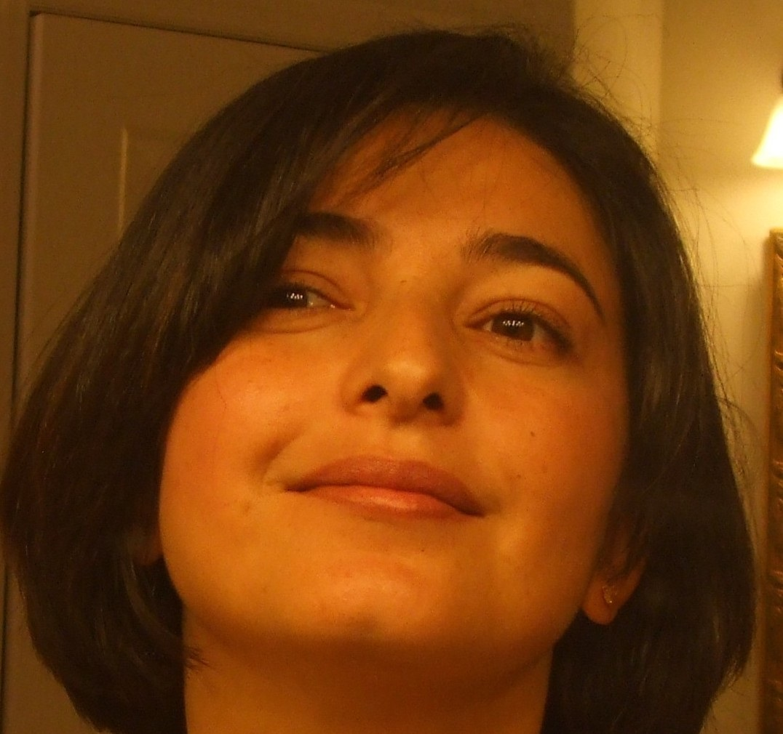
Hello!
I am Kathy Joshi
You can find me at:
Kathy@rladies.org
kathyjoshi1030@gmail.com

Slide 4
1.
R-Ladies Global
History | Mission Statement | Code

Slide 5
What is R-Ladies?
#rdogladies

Slide 6
Worldwide organization that promotes diversity in the #rstats community via meetups and mentorship in a friendly and safe environment

Slide 7

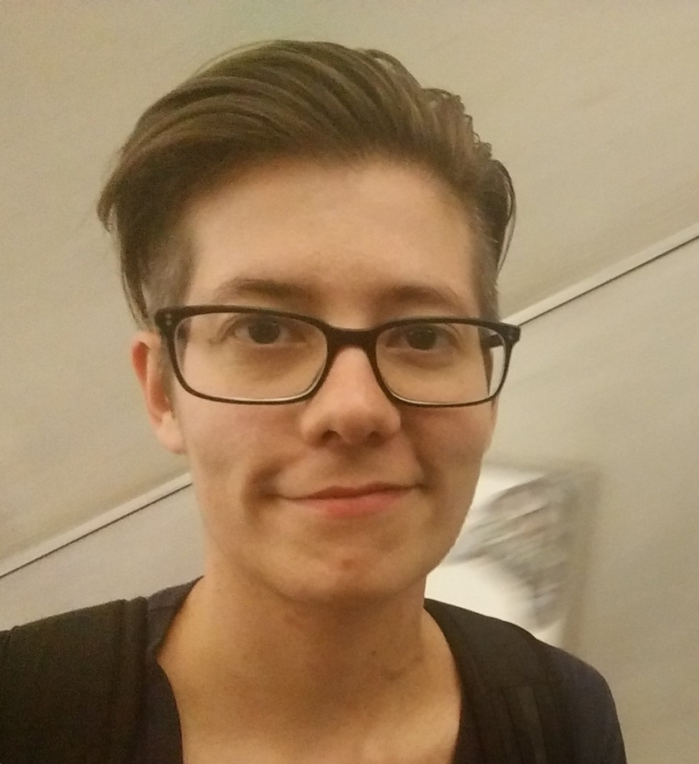
Who we are
The Leadership Team
Alice Daish
Claudia vitolo
Hannah frick
erin ledeLL
Gabriela de Queiroz
London
San Francisco

Slide 8
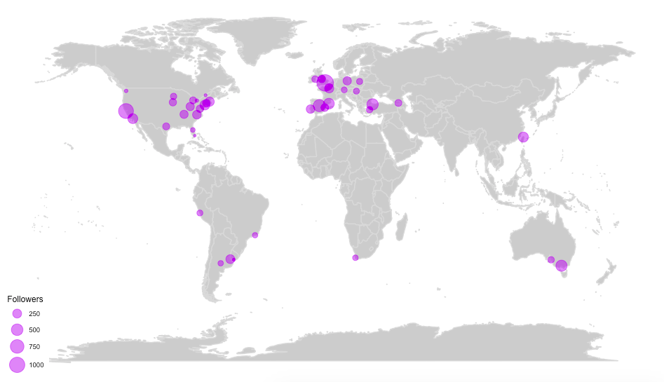
History
▪ Gabriela de Queiroz, Data Scientist
▪ San Francisco, Oct 2012
▪ 770 members, 30+ past meetups
▪ London, Jan 2016
▪ 694 members, 15 past meetups
▪ 40+ chapters as of July 2017 (including Paris, Melbourne, Istanbul, Tbilisi, Barcelona, Buenos Aires, Taipei and Berlin)

Slide 9
14% R package developers are female
30% Female participants at useR! 2016

Slide 10
Mission
Improve the participation and experience of women in the R community - to achieve a proportionate gender representation in R community
Support R enthusiasts who identify as female to help them achieve their programming potential by building a collaborative network of R leaders, mentors, learners and developers to facilitate individual and collective progress worldwide.

Slide 11
Code of Conduct
R-Ladies is dedicated to providing a harassment-free experience for everyone. We do not tolerate harassment of participants in any form.
This code of conduct applies to all R-Ladies spaces, both offline and online, including: meetups, Twitter, Slack, mailing lists. Anyone who violates this code of conduct may be sanctioned or expelled from these spaces at the discretion of the Founding Members. (...)
If you are being harassed by a member/guest/participant of/at R-Ladies, notice that someone else is being harassed, or have any other concerns, please contact the Founding Members via reporting@rladies.org

Slide 12
A diversity of thought, perspective and culture is important in any field (...) Surround yourself with people who support you and get involved in [coding] programs.
—Sarah Friar CFO of Square (POS software)

Slide 13
2. R-Ladies Orlando
Why | When |Who

Slide 14
R-Ladies Orlando
Why are we here:
Improve R knowledge
Meet new people
Expand professional network
Get involved in R community in general
What we expect:
Monthly presentations
Monthly workshops
Beginners Tutorials and Mentoring
Informal networking

Slide 15
R-Ladies Orlando
When:
Formal Monthly Meetings
Informal one-to-one mentoring for beginners
Who:
Would like to get to know all of you, a little background and expectation survey

Slide 16
3. Action Plan
Ideas | Projects | Mentorship

Slide 17


Slide 18

Action Plan
Work on a community project, that we all can contribute to, preferably one that relates to Orlando or Florida; an R package or product.
Offer one-to-one mentorship; align seasoned R-Ladies with Newbies.
Fun workshops

Slide 19
Online presence
▪ Website: http://www.rladies.org
▪ R-Ladies directory: https://rladies.org/ladies/
▪ Email: info@rladies.org and orlando@rladies.org
▪ Twitter: @RLadiesGlobal and @RLadiesOrlando
▪ Slack: http://r-ladies.slack.com channel: #rladies-Dublin
▪ GitHub: http://github.com/rladies

Slide 20
For Beginners

Slide 21
What is R
R is a programming language and software environment for statistical computing and graphics.
Created by Ross Ihaka and Robert Gentleman- University of Auckland (1992-1995)
Open source project

Slide 22
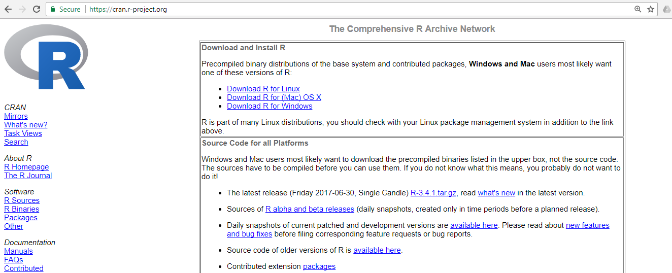
To Download R
Go to CRAN, the comprehensive R archive network.
Choose Windows or Mac
Follow instruction to download

Slide 23
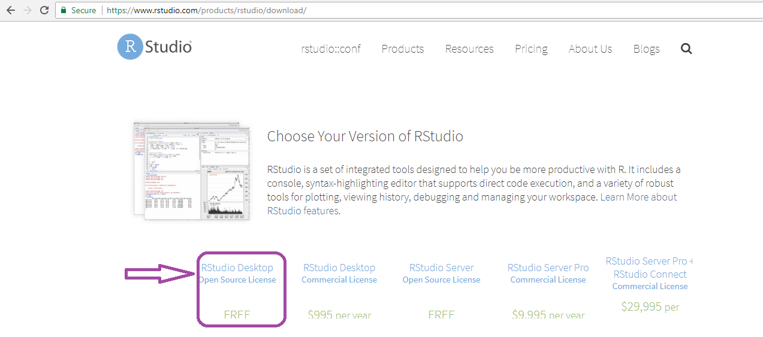
RStudio
RStudio is an integrated development environment or IDE, for R programming.
Download and install it from http://www.rstudio.com/download

Slide 24

What is Github?
GitHub is a web-based Git or version control repository and Internet hosting service.
It offers all of the distributed version control and source code management (SCM) functionality of Git as well as adding its own features.
It provides access control and several collaboration features such as bug tracking, feature requests, task management, and wikis for every project.
Why do I need it?
Extremely popular
A community of developers sharing code and contributing to projects

Slide 25

#rdogladies

Slide 26

#rchickenladies

Slide 27

#rcatladies

Slide 28
